Slide 1
Modelling Cognitive Brain Processes
CS298 Master’s Defense
Adithya Harish Kumar
Department of Computer Science
San José State University
Advisors
Dr. Chris Pollett
Dr. Robert Chun
Dr. Sayma Akther

Slide 2
Presentation Roadmap
Project Overview
  Motivation, Project Goals and Impact
Background
  Related work, multimodal models, agent orchestration
Preliminary Work
  CrewAI baseline, Topology Manager design, Housefly simulation
Implementation
  Phi-3.5-mini-instruct finetuning
  Multimodal processing
  Visual cortex modeling (dorsal-ventral, V2-V4-V5 pathways)
  Saliency visualizer
Experimental Results
  Reasoning benchmarks
  CLEVR + COD10K Experiments
  Visual Saliency evaluation
Conclusion & Future Work
  Key findings, impact, and research directions

Slide 3
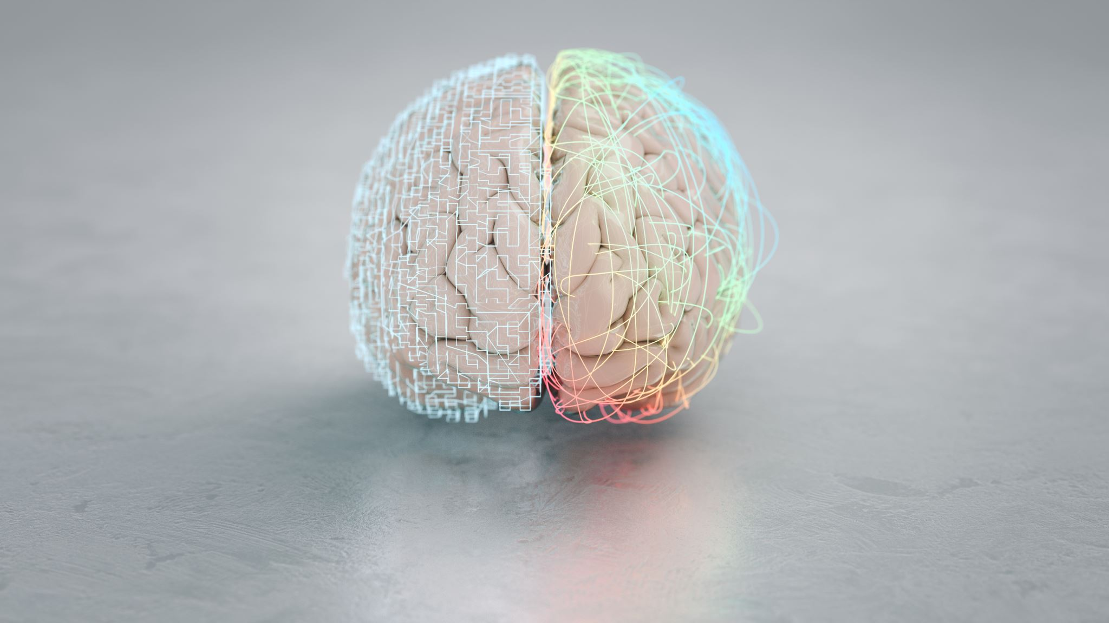

Project Overview
Motivation
  Simulate complex cognitive and perceptual brain processes using AI agent systems
  Leverage Large Language Models (LLMs) to model human-like reasoning and multimodal perception
Project Goals
  Build modular agent-based simulations of the visual cortex using LLM topologies
  Enable cognitive functions like contour detection, motion, and color perception via coordinated agents
  Develop the Topology Manager framework for flexible deployment and interaction of LLM agents
  Fine-tune advanced models (Phi-3.5-mini-instruct) for logical reasoning and integrate with multimodal tasks
Impact
  Demonstrates the potential of multi-agent LLM systems to provide interpretable, human-inspired cognition
  Lays groundwork for future developments in brain-like AI architectures and multimodal understanding

Slide 4
Background - Related Work
Dennett et al. [1] Proposed the Multiple Drafts Model (MDM) of consciousness
Rejects a single “central observer”; consciousness arises from parallel, competing narrative drafts. Explains subjective experience via distributed, heterarchical processing rather than a unified stream; accounts for phenomena like temporal illusions, confabulation, and post-hoc editing through decentralized interpretive processes
Chen et al. [5] built a large-scale V1 model integrating anatomical + neurophysiological data. Replicated visual processing traits: robustness to noise, temporal stability, distributed feature detection
Wang et al. [6] CLIP-trained ResNet50 explained ~79% of voxel response variance in hold-out brain data. Outperformed models trained only on images or text
Wang et al. [8] Video saliency model trained on DHF1K dataset (1,000 clips, 250Hz eyetracker). Improved spatio-temporal saliency predictions with DeepLabV3; analyzed age-related fixation patterns (20–28 yrs)
Hulse et al. [9] → Mapped the full synapse-level connectome of the Drosophila central complex. Revealed circuit motifs supporting flexible navigation & action selection
Identified recurrent loops, fan-in/fan-out pathways, and compass–sensory integration channels enabling context-dependent behavior; provides a high-resolution neural architecture for biologically grounded navigation models
Notes:
Hulse et al. reconstructed the synapse-level connectome of the Drosophila central complex using large-scale EM data, such as recurrent loops, fan-in/fan-out pathways, and cell-type–specific integration channels, The work quantitatively identifies circuit asymmetries, convergence ratios, and connectivity strengths that together form a computational architecture for goal-directed navigation and context-dependent action selection, making it a foundational reference for understanding biologically grounded navigation models.

Slide 5

Background - Multimodal Language Models
From text-only → Vision + Language reasoning
Key systems: GPT-4, Gemini, LLaVA → combine pretrained LLMs with Vision Transformers (ViTs)
Applications: Image captioning, VQA, multimodal reasoning
Impactful models:
  DALL-E → Generates realistic images from text prompts → simulates “mental imagery.”
  Flamingo → Few-shot multimodal model → learns cross-modal tasks with minimal supervision
Scientific Relevance:
  Replicates dorsal (where) + ventral (what) streams of the visual cortex
  Provides better saliency prediction & scene understanding than unimodal approaches

Slide 6
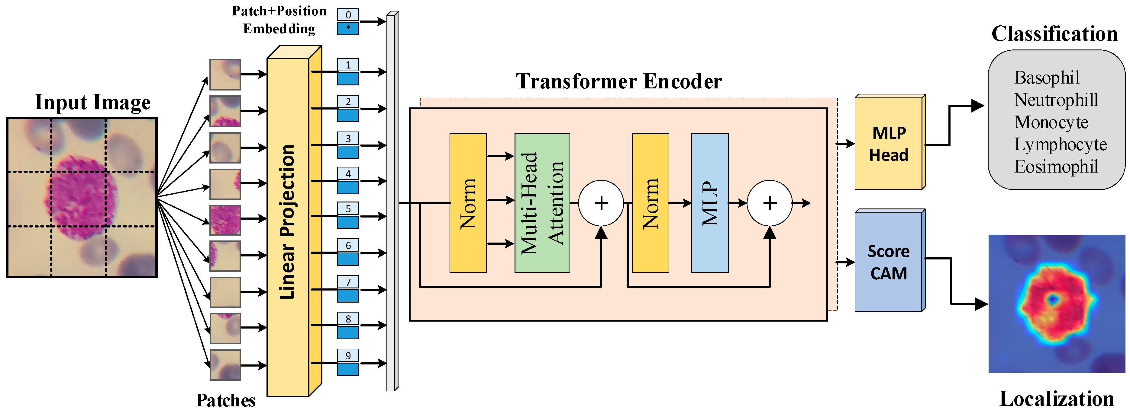
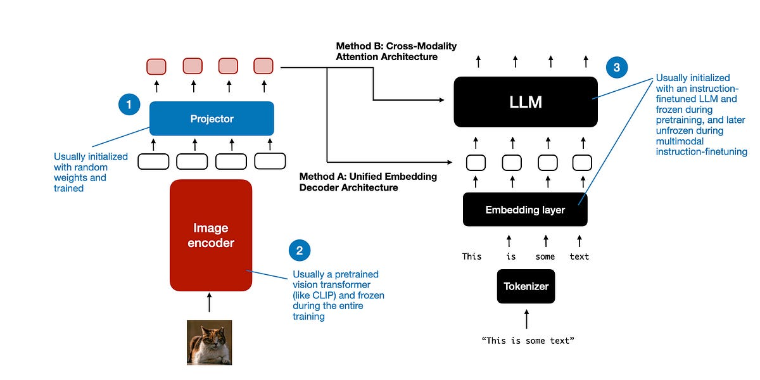
Vision Transformer
Multimodal Architecture

Slide 7
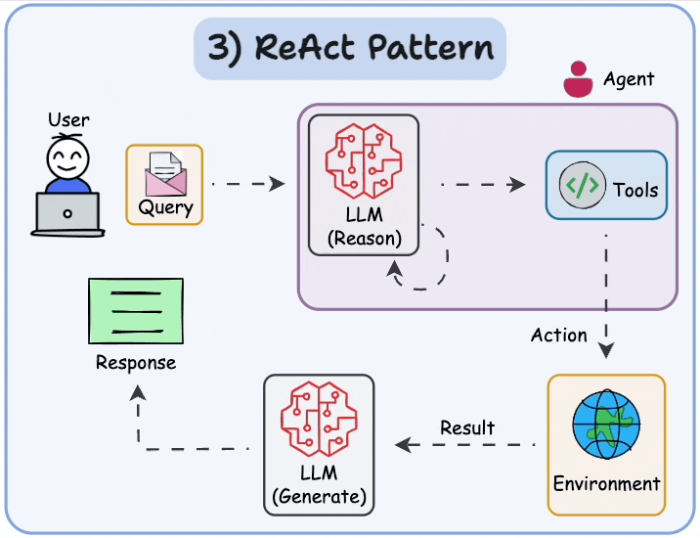
Background - Agent Orchestration
Multi-agent LLMs = multiple specialized models collaborating
Frameworks:
  Crew AI, AutoGPT → agents with specific roles & goals
  Limitation: Communication often opaque
Advances:
  LangGraph, ReAct, Chain-of-Thought (CoT) → structured, step-by-step reasoning flows
  Retrieval-Augmented Generation (RAG) → connects agents to external vector DBs (FAISS, LanceDB) for dynamic domain knowledge
Why it matters:
  Supports modular, interpretable, distributed reasoning
  Enables brain-inspired systems where agents = cortical regions with controlled pathways

Slide 8
Preliminary Work - Dennett’s Multiple Drafts Model
Core Ideas
  Proposed by Daniel Dennett in Consciousness Explained (1991)
  Denies any central “Cartesian Theater” (no single place or moment in the brain where consciousness “happens”)
  Instead, there are parallel, multitrack processes: different subsystems of the brain make content‐fixations (detecting features, interpreting sensory inputs, etc.) at different places and times
Mechanisms & Implications
  These content‐fixations are continuously edited (“drafts”)—new interpretations, revisions, additions—across time
  Not all “drafts” reach what we consider full conscious awareness; only some become “famous” or influential enough to affect behavior, memory, report
  Consciousness is thus dynamic, distributed, and emergent—tied to behavior and the capacity of content to influence actions rather than to the presence of a single, fixed observer
Why It Matters for Cognitive Modeling
  Motivates designing systems with modular, parallel sub‐agents rather than monolithic sequential pipelines
  Suggests focus on how drafts (partial interpretations) are generated, edited, and selected
  Offers a framework to compare artificial systems to human‐like consciousness in terms of integration, revision, and competition among representations

Slide 9
Preliminary Work – CrewAI Implementation
Objective
Create a baseline system that follows Dennett’s model: multiple agents (“drafts”) working in parallel, then integrated, to simulate aspects of conscious processing
Framework: CrewAI multi‐agent LLM system
Agents:
  LLM1 (Quantitative Focus) — extracts and summarizes numerical/quantity information
  LLM2 (Logical Relationships Focus) — identifies logical relations, interactions, structures in the input
  Primary LLM (Integrator) — takes outputs from LLM1 and LLM2 and produces final answer
Procedure
  Feed 20 input questions/tasks: arithmetic (quantities), logic, everyday reasoning
  Agents work in parallel, produce their “drafts,” then integrator synthesizes into final output
  Observe and document not just correctness, but how partial interpretations differ, what is preserved or discarded, whether context or realism enters into the integrator’s answer (beyond raw logical quantity)

Slide 10
Preliminary Work – CrewAI Implementation
Task | Quantitative Agent (LLM1) Output | Logical Agent (LLM2) Output | Final Answer (Integrator)
“I have 100 apples. I gave 20 to my sister and 10 to my brother. How many are left?” | Summarized quantities: 100, 20, 10 | Logical: gave away, subtract, remaining | 70 apples
“There are 10 crows on an electric line. If a hunter shoots the leftmost crow … how many remain?” | Quantities: 10 initially, 1 shot | Relations: removal, context of noise scaring away others | 0 crows (realism); or 9 if only raw subtraction considered
Logical syllogism (“All trucks fly…” etc.) | Identifies premises’ quantities/attributes | Derives relations among categories; checks validity | Correctly rejects invalid conclusions; selects only supported ones

Slide 11
Preliminary Work – Topology Manager
Purpose
Framework to orchestrate LLM interactions with fine-grained control
Goes beyond CrewAI → lets us decide which agents talk, how data flows, and what is shared
Inspired by Infrastructure-as-Code (IaC) → reproducible, configurable, and scalable
Key Features
Declarative config → Graph-based agent topologies defined in JSON.
Version-controlled & reproducible → Easy rollback & deployment
Automated deployment & scaling → Minimal human intervention
Consistency across environments → Prevents human error

Slide 12
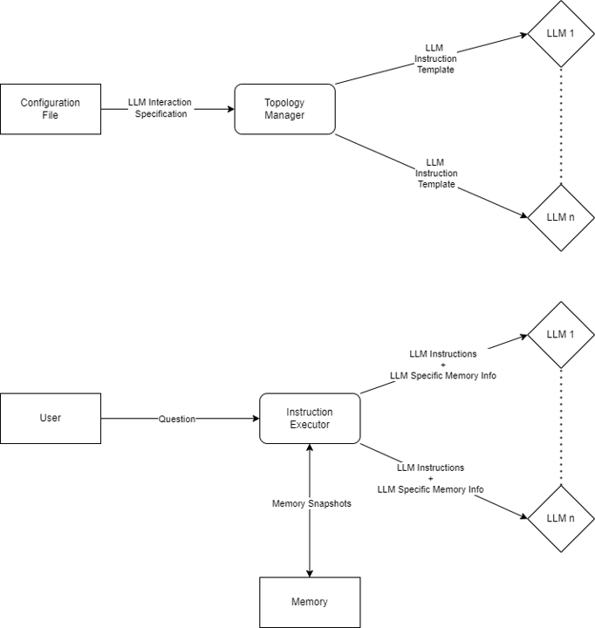
Preliminary Work – Topology Manager

Slide 13
Preliminary Work – Topology Manager
Architecture
  Configuration File → Blueprint of agents + interaction graph
  Topology Manager → Builds hierarchy, topological sorting, execution order
  Instruction Executor → Central processor, query handler, memory snapshot support
  Memory Module → Context persistence via snapshots
  LLM Modules → Cloud (OpenAI, Gemini, OpenRouter) + local (Ollama, LM Studio)
Supporting Modules
  Config (validation & cycle checks)
  Core (module interaction, async comms)
  DB (RAG, vector DB abstraction)
  Manager (agent orchestration in topological order)
  Model (LLM abstraction layer)

Slide 14
Preliminary Work – Topology Manager (RAG)
Purpose
  Enhance LLM inference with query-relevant retrieval
  Enables offline execution without cloud LLMs
  Improves accuracy, adaptability, and contextual reasoning
Pipeline Components
  Web Scraping → Async Python crawler for latest info
  Vector DB (LanceDB) → In-memory multimodal storage & retrieval
  Embedding Model → nomic embed v1.5 (384-dim multimodal embeddings)
  On-Device LLM (Ollama) → Consumes retrieved results; cloud-free inference
Benefits
  Contextual Understanding via efficient retrieval
  Improved Accuracy using latest, web-backed info
  Adaptive Learning → continuously updating knowledge base

Slide 15
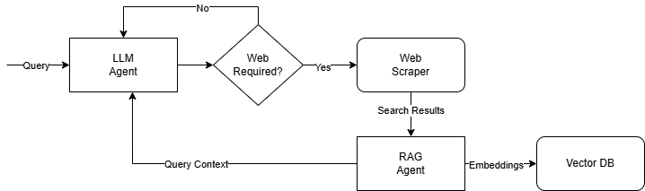
Preliminary Work – Topology Manager (RAG)

Slide 16
Preliminary Work – Topology Manager
Question | LLM 1 | LLM 2 | Primary | Answer
I have 100 apples. I gave 20 apples to my sister and 10 apples to my brother. How many apples do I have left? | You started with 100 apples. You gave 20 to your sister and 10 to your brother. Subtracting gives 70 apples remaining. | To find how many apples are left, subtract 20 (sister) and 10 (brother) from 100 → 70 apples left. | You would have 70 apples left. Calculation confirms: 100 – 20 – 10 = 70. | 70 apples
There are 10 crows on an electric line. If a hunter shoots the leftmost crow and it falls to the ground, how many crows will be left on the electric line? | The question describes 10 crows. After the hunter shoots one, 9 remain on the line. | Logical relation: one crow is removed, so 9 remain on the line. | There will be 9 crows left on the line. | 9 crows
Statements: All trucks fly. Some scooters fly. Conclusions: All trucks are scooters. Some scooters do not fly. Which of the conclusions are correct? | “All trucks are scooters” is not correct. “Some scooters do not fly” is correct as per the statements. | From “All trucks fly” + “Some scooters fly,” the correct conclusion is that some scooters do not fly; all trucks are scooters is unsupported. | Correct conclusion: “Some scooters do not fly.” Incorrect: “All trucks are scooters.” | Conclusion 2 is correct; Conclusion 1 is incorrect

Slide 17
Preliminary Work – Topology Manager
Accuracy on 20 Questions
CrewAI | Topology Manager
80% | 75%
Accuracy on 20 Reasoning Questions

Slide 18
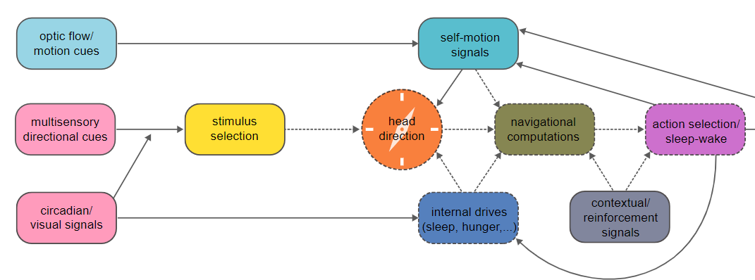
Preliminary Work – Housefly Vision Simulation
Goal
  Model the sensorimotor pathway of a housefly using the LLM Topology Manager
  Proof-of-concept for extending to more complex human-like visual systems
Subsystems Implemented (7 total)
  Stimulus Selection
  Head Direction
  Internal Drives
  Circadian Rhythm Simulation
  Multisensory Integration
  Self-Motion Processing
  Optic Flow Simulation
Key Idea
  Each subsystem = modular LLM agent with biologically inspired inputs & outputs
  Collectively simulate decision-making → perception-driven behavior
Housefly Brain Process

Slide 19

Preliminary Work – Housefly Vision Simulation
Implementation
  Added conversational memory to store previous outputs as dictionaries
  Used summarization to prevent cascading context overload
  Enabled episodic generation → agents aware of past states, not just current stimuli
Impact
  Simulated continuous & adaptive behavior, closer to real insect responses
  Actions depended on history + current input, not isolated events
  More realistic framework for studying how organisms adapt to dynamic environments
Outcome
  Successfully reproduced adaptive fly-like behavior
  Establishes foundation for modelling higher-order visual systems

Slide 20
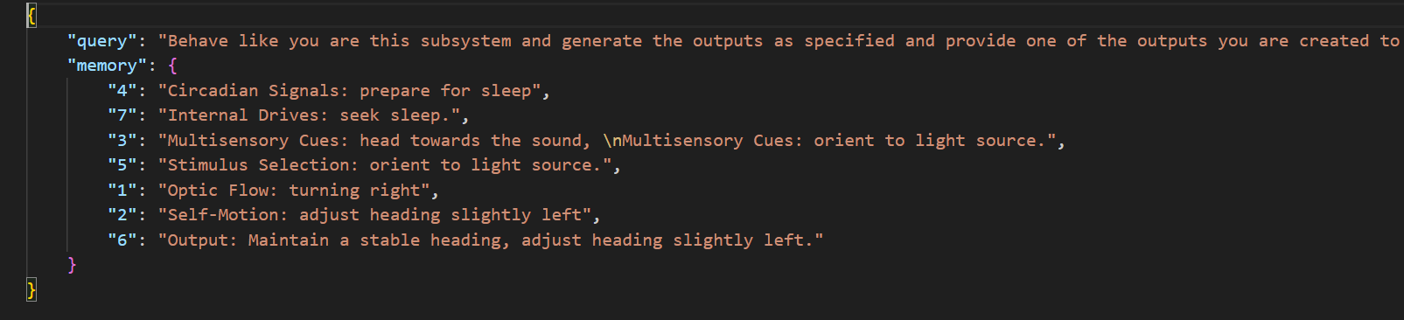
Preliminary Work – Housefly Vision Simulation
Vision Simulation for a particular Timestep

Slide 21
Implementation - Finetuning Phi-3.5-mini-instruct
Model Details
  Phi-3.5-mini-instruct: Decoder-only transformer, 3.8B parameters
  Pre-trained for instruction-following, reasoning, and multimodal tasks
  Trained on high-quality reasoning datasets, synthetic data, and image-caption pairs
Purpose of Finetuning
  Adapt the model for instruction execution and multimodal reasoning
  Resolve competing outputs from modular LLM subsystems, inspired by biological attention mechanisms
  Serve as the key reasoning layer for the overall cognitive modeling framework
Implementation Setup
  Platform: Google Colab, consumer-grade GPU
  Memory Optimization: 4-bit quantization to fit model on limited VRAM
  Optimization Techniques: Unsloth → reduces memory & training overhead without affecting accuracy
  Pipeline: Base64 image integration → support visual queries

Slide 22
Implementation - Finetuning Datasets and Metrics
Datasets Used
  ReClor – 6,000+ multiple-choice reasoning questions from graduate-level exams
    Each datapoint: prior context + question + 1 correct answer
    Trains logical inference & decision-making
  LogiQA – 2,442 independent reasoning questions
    Used to prevent overfitting to ReClor
    Ensures generalization beyond one dataset
Training & Monitoring
  Monitored training & validation loss on ReClor; noted potential overfitting
  Validated periodically on LogiQA
  Stopped training around 100 iterations when LogiQA accuracy plateaued
Results
  ReClor: Steady loss decrease, model learned dataset-specific reasoning
  LogiQA: Final accuracy ~72%, indicating balanced reasoning generalization
  Outcome: Phi-3.5-mini-instruct can integrate multimodal inputs and act as a decision arbiter for modular LLM subsystems
Impact
  Provides robust reasoning layer for hierarchical LLM setups
  Supports distributed attention simulation in visual and cognitive tasks

Slide 23
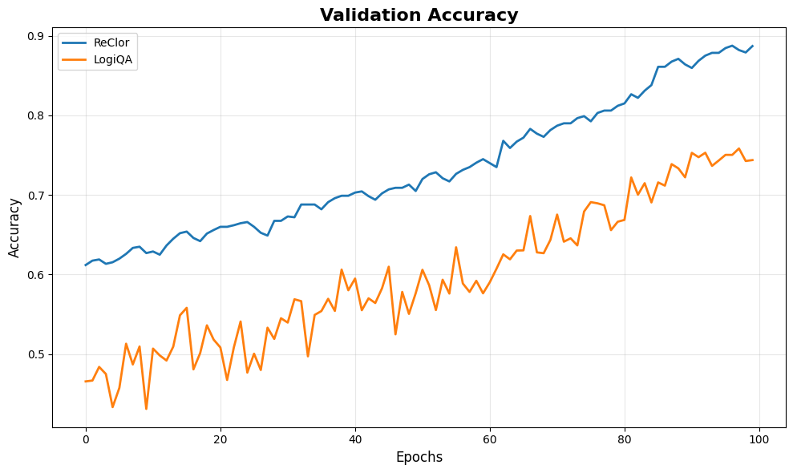
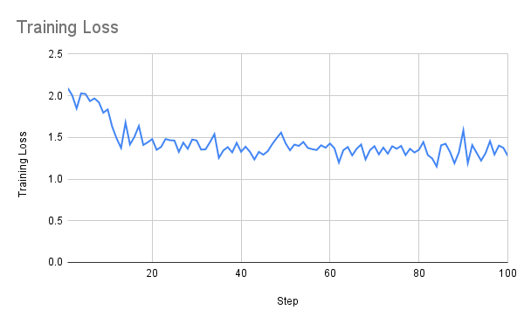
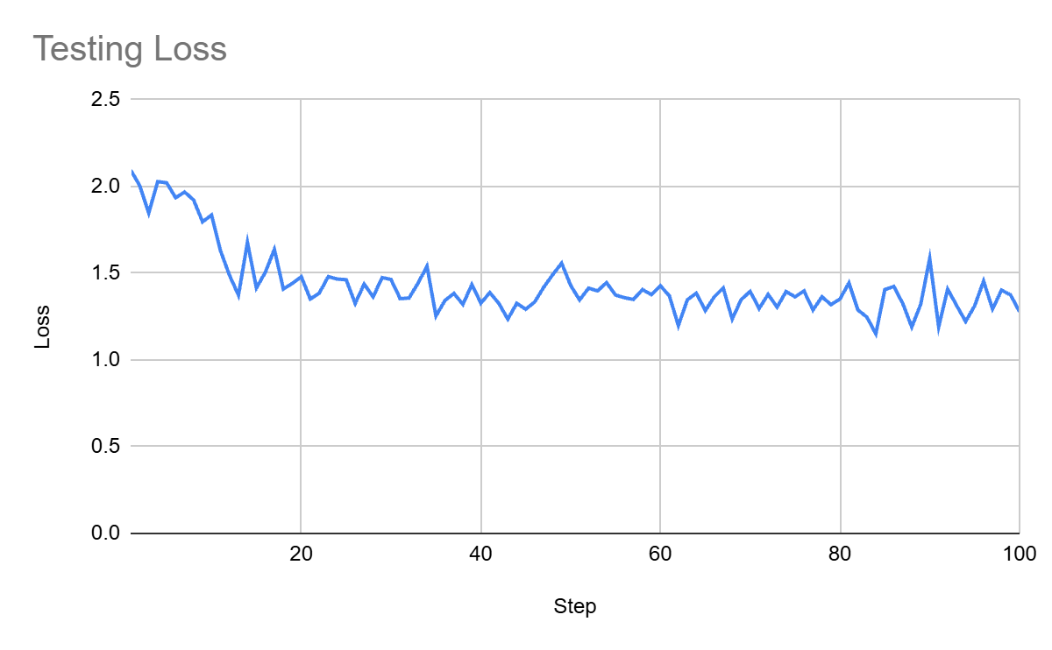
Implementation - Finetuning Phi-3.5-mini-instruct

Slide 24
Implementation - Multimodal Support
Objective
  Extend LLM Topology Manager to handle both text and image inputs
  Simulate visual cortex-inspired networks where agents process multimodal information in parallel
Key Enhancements
  Multimodal Input Handling
    Queries now accept text + base64-encoded images
    Encoded images stored in conversation memory to avoid recomputation
    Supports seamless integration with cloud APIs or local LLMs
  Instruction & Memory Updates
    Instruction class now supports dict-based text-image objects
    Memory module stores historical multimodal data, enabling context-aware reasoning
  Architecture Impact
    Compatible with existing text-based reasoning → backward compatible
    Modular design allows future extensions for other data types
    Enhances LLMs’ ability to reason over visual context + textual information simultaneously
Outcome
  Supports multimodal networks for integrated perception tasks
  Enables structured, reusable, and parallel reasoning across text and visual streams

Slide 25

Implementation – Saliency Visualizer
Frontend Design
Built using Vite + React as a single-page application
Uses reusable components:
  Image upload
  Image card with subsystem outputs
  Description and conversation display
Two-way bound image preview on upload
Service layer:
  Formats input for backend
  Handles multipart requests
  Parses JSON responses for display

Slide 26
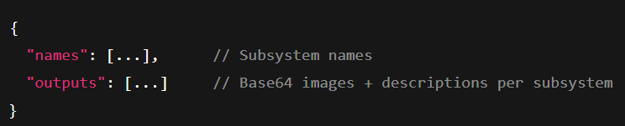
Implementation – Saliency Visualizer
Output Structure
  Subsystem name
  Base64-encoded image
  Explanation of focus region

Slide 27
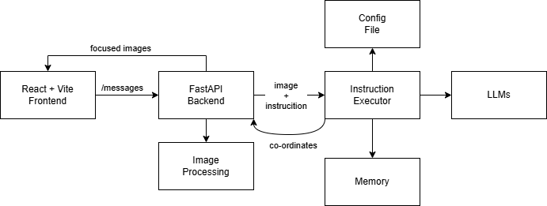
Implementation – Saliency Visualizer
Backend Design
  Built using FastAPI + Uvicorn for asynchronous requests
  Initializes InstructionExecutor on startup with:
    Graph-based configuration files
    Agent communication rules
  Provides /messages endpoint to handle image inputs
Processing Pipeline
  Instruction Execution:
    Validates inputs
    Runs image through modular LLM agents
    Each subsystem predicts regions of focus
  Image Processing:
    Circular focus regions extracted based on coordinates
    Gaussian blur applied to non-focused regions (25x25 kernel)
    Overlay focused regions onto blurred image to simulate saliency
  Response:
    Structured output per subsystem
    Includes image + explanation
    Returned to frontend for interactive visualization
High Level Architecture

Slide 28
Implementation – Visual Cortex
System Design
  Integrated previously developed components into a single interactive system
  InstructionExecutor framework:
    Auto-deploys modular agent-task inference patterns
    Subsystems are nodes in a directed graph, each producing focused outputs
    No need to modify LLM internals; functionality is prompt-driven
  Output Processing:
    Subsystem outputs are visualized via image pipeline to highlight attention
    Enables a scalable and modular simulation of visual processing
  Key Feature: Parallel, modular, prompt-driven subsystems emulate biologically inspired visual cortex behavior

Slide 29
Implementation - Visual Cortex
Dorsal-Ventral Pathway Simulation
Objective: Model the classical "what" vs "where" visual pathways
  Ventral Pathway (“What”):
    Performs object recognition and feature extraction
    Detects textures, colors, shapes in the scene
  Dorsal Pathway (“Where”):
    Processes spatial relationships, motion, and object trajectories
Implementation Approach:
  Separate prompts for dorsal vs ventral tasks
  Both paths executed in parallel via Topology Manager
  Modular agents allow flexible downstream integration and attention visualization

Slide 30
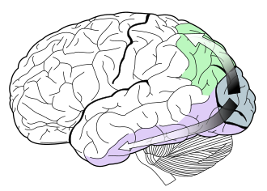
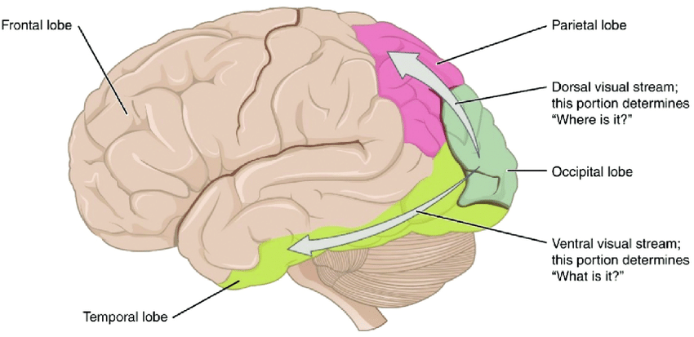
Implementation - Visual Cortex
Dorsal-Ventral Stream
The dorsal stream (green) and ventral stream (purple) are shown. They originate from primary visual cortex.

Slide 31
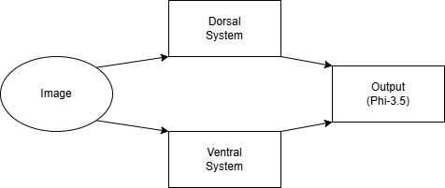
Implementation - Visual Cortex
Dorsal-Ventral Subsystem

Slide 32
Implementation - Visual Cortex
V2-V4-V5 Hierarchical Subsystem
Objective: Simulate an agentic visual hierarchy in human cortex
  V2 Agent:
    Extracts edges, shapes, contours, and anomalies from input images
  V4 Agent:
    Focuses on color, contrast, texture, and object properties
  V5 Agent:
    Responsible for motion detection, object tracking, and dynamic scene analysis
Architecture & Flow:
  Prompt-driven, multi-agent setup, comparable in scale to dorsal-ventral system
  Outputs processed via image post-processing pipeline
  Each agent produces focused image + textual description for attention visualization

Slide 33
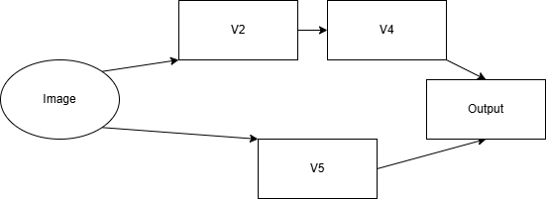
Implementation - Visual Cortex
V2-V4-V5 system

Slide 34
Experiments - CLEVR
Dual-Stream Visual Reasoning
The human visual system processes information through two complementary pathways:
  Ventral stream — object recognition (“what”).
  Dorsal stream — spatial estimation and motion (“where”).
Hypothesis
A dual-stream agent that separates object recognition (ventral) from spatial estimation (dorsal) will produce object distance judgments closer to human annotations (i.e., lower Mean Absolute Error) than a single multimodal LLM that reasons over the whole image jointly.
Goal:
Test whether this modular perception architecture leads to more human-like spatial reasoning

Slide 35
Experiments – CLEVR
Dataset Summary:
  ~100,000 Synthetic 3D scenes with simple objects (spheres, cubes, cylinders).
  Each object annotated with shape, color, size, material, and position.
  Enables precise measurement of object distances and spatial relationships.
Why CLEVR for Dorsal–Ventral Evaluation:
  Objects are visually distinct but spatially complex, mirroring the need for both:
    Ventral: to recognize and identify objects.
    Dorsal: to estimate positions and relative distances.
  Controlled nature of CLEVR allows testing modularity of perception — whether decoupling recognition and spatial estimation yields better spatial understanding.
Setup:
  Sampled 100 CLEVR scenes.
  Collected object distance judgments from:
    Single Multimodal LLM (LLaMA 3.2 90B)
    Dual-Stream (Dorsal–Ventral) Agent
    Human annotations

Slide 36
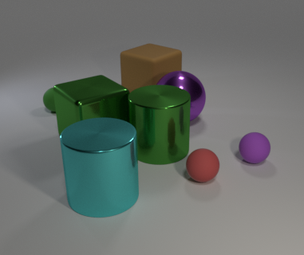
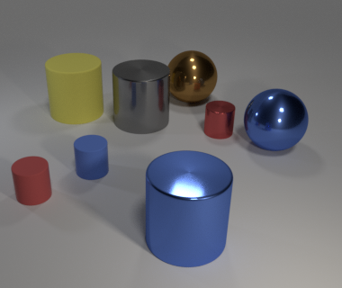
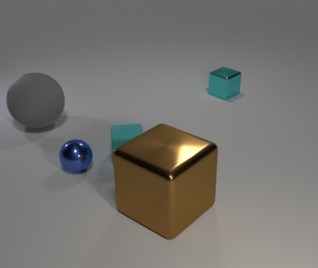
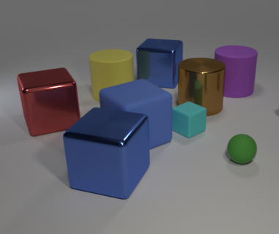
Experiments – CLEVR

Slide 37
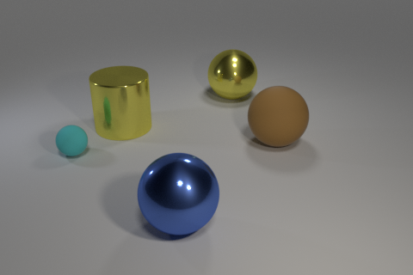
CLEVR Dataset
Question | LLaMA 3.2 90B | Dual Stream Agent
Are there any other things that have the same material as the large brown object? | Yes, based on the image, the following objects have the same material: The small green sphere The large yellow cylinder They all have a shiny, reflective, metallic appearance. | No, there are no other objects in the image that have the same material as the large brown object. The large brown object has a matte, non-reflective surface, while the other objects have different materials—several are shiny and metallic, and one is matte but a different color.

Slide 38
Experiments – COD10K
Hierarchical Visual Processing Enhances Camouflage Detection
The human visual cortex detects camouflaged or low-contrast objects through a hierarchical cascade of visual areas:
  V2 — accentuates edges, orientation contrasts, and boundaries, revealing subtle contours.
  V4 — integrates shape and color constancy, distinguishing objects from textured or noisy backgrounds.
  V5 (MT) — contributes motion and dynamic texture sensitivity, aiding detection when objects or backgrounds have temporal variation.
Hypothesis
  A system modeled on the V2–V4–V5 hierarchy will outperform a generic multimodal LLM baseline in camouflage detection tasks, due to its progressive refinement from low-level to high-level visual cues.
Goal
Evaluate if biologically inspired hierarchical feature extraction yields improved detection accuracy for camouflaged objects.

Slide 39
Experiments – COD10K
MM-CamObj Dataset for Camouflage Detection
Dataset Summary:
  Contains ~12,000 synthetic and real images of camouflaged objects (animals, shapes, or patterns) blended into complex or noisy backgrounds.
  Each image includes ground-truth masks or bounding boxes for object locations.
  Balanced across varied textures, lighting, and motion cues (for temporal sequences).
Why This Dataset Tests the V2–V4–V5 System:
  V2-level features: Edge enhancement helps in revealing subtle contour discontinuities.
  V4-level processing: Shape and color constancy disambiguate objects from chromatically similar surroundings.
  V5-level dynamics: Detects motion differences between object and background, useful for temporal camouflage.
  Together, these mimic the human cortical pipeline, making the dataset ideal to test progressive cue integration in camouflage detection.
Setup:
  Sampled 100 images from the camouflage dataset.
  Measured detection accuracy for:
    Baseline Multimodal LLM (LLaMA 3.2 90B)
    V2–V4–V5 Hierarchical Agent
    Human annotations

Slide 40
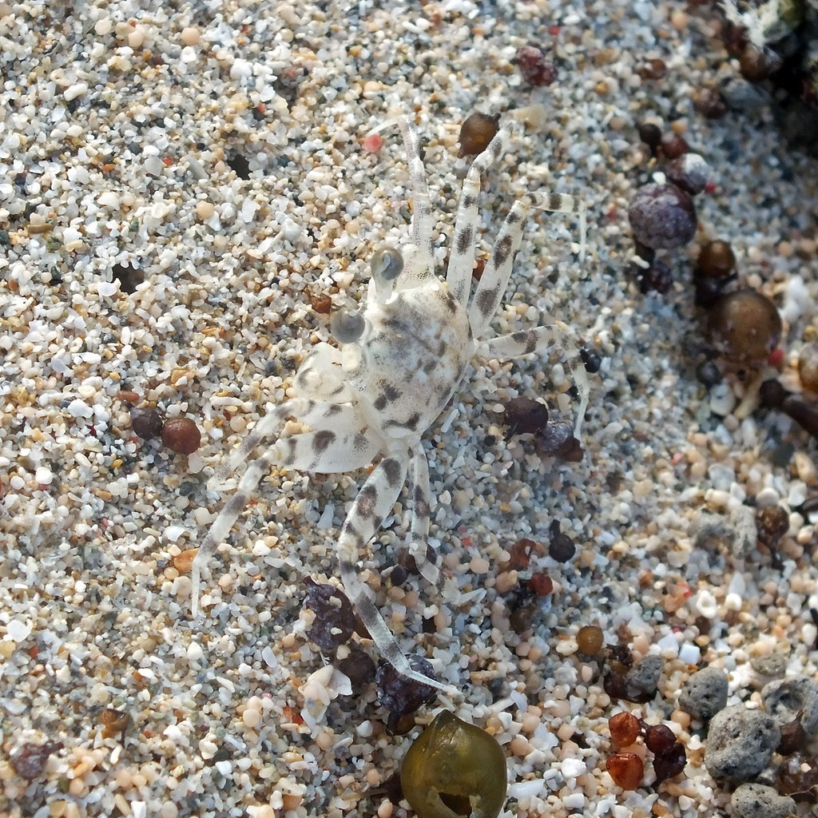
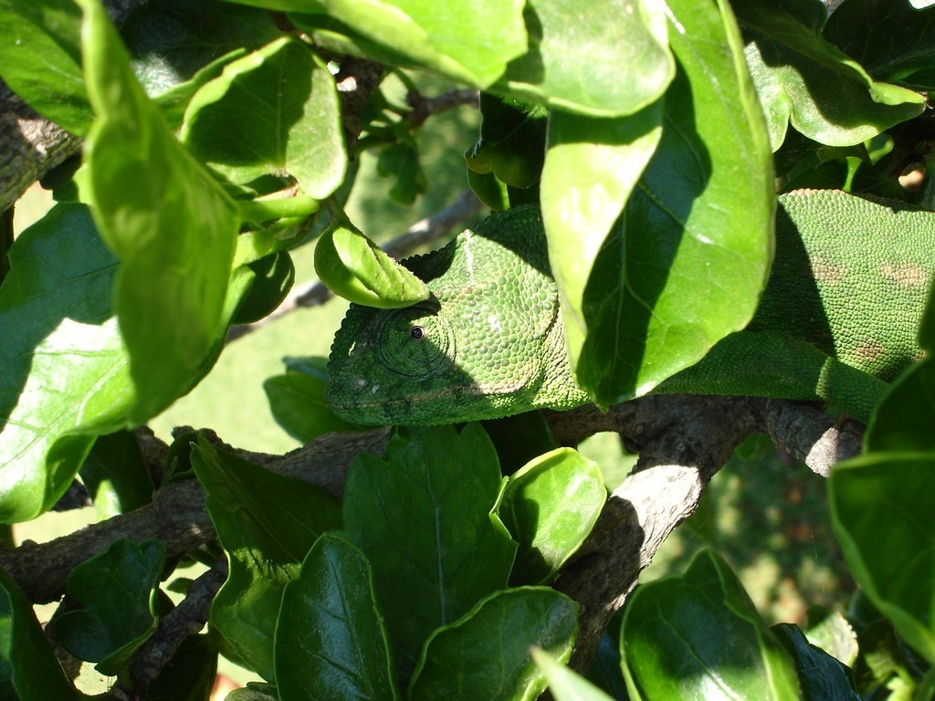

Experiments – COD10K

Slide 41
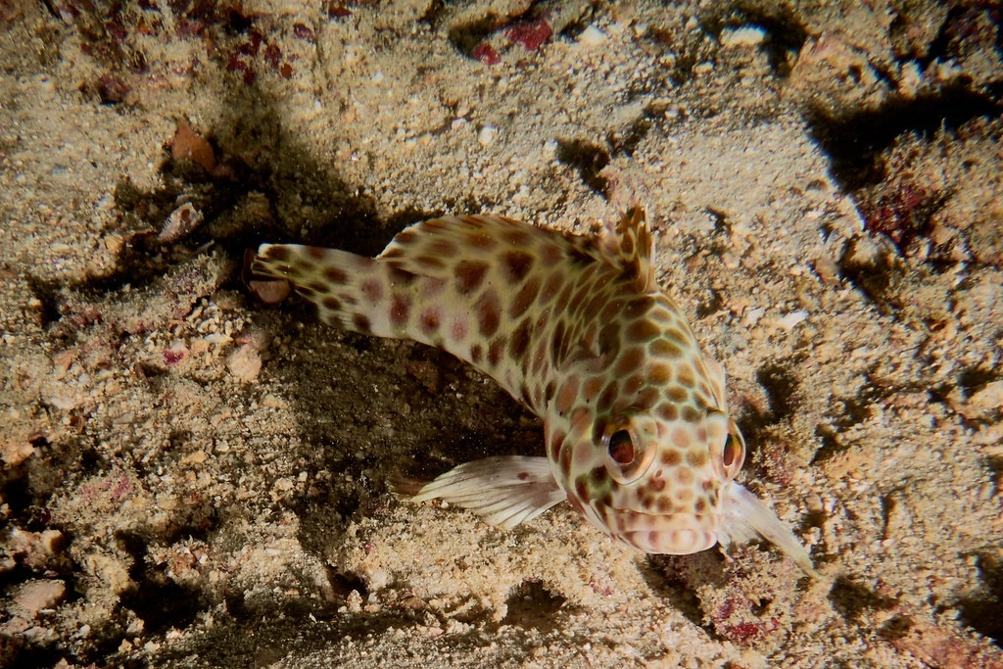
COD-10K Dataset

Slide 42
Experiments– Visual Saliency
Dataset: Where People Look Dataset (Eye-Tracking) with ~1000 images
Type: Eye-tracking dataset with fixation maps
Fixation Maps: White regions indicate high human attention/intensity
Evaluation Method:
  Predicted coordinates from model compared against ground truth fixation maps
  Weighted precision score computed for predicted regions
  Single predicted point compared to multiple intensity regions in fixation maps
Purpose: Assess ability of visual subsystems to predict human-like focus points in images
F1: 0.59 (Using V2-V4-V5 Subsystem)

Slide 43
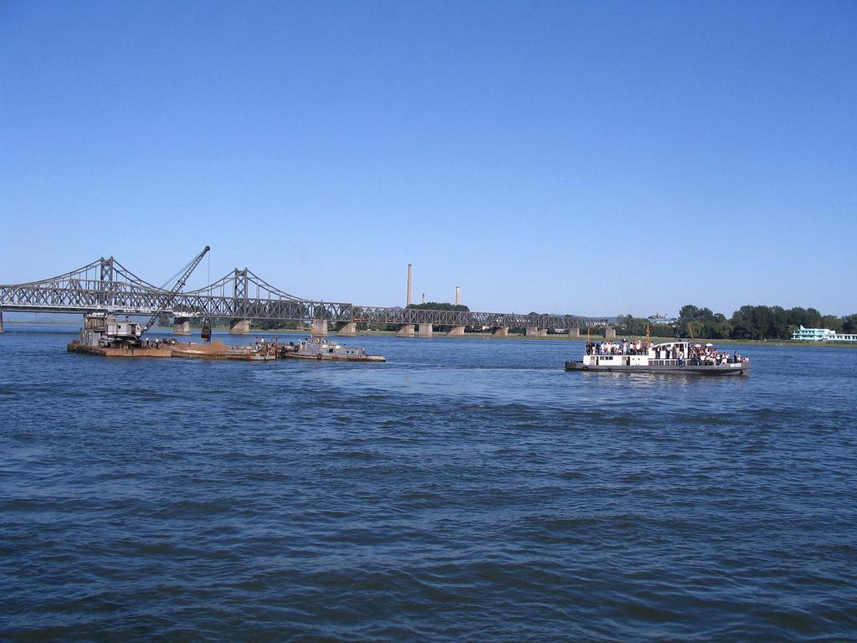
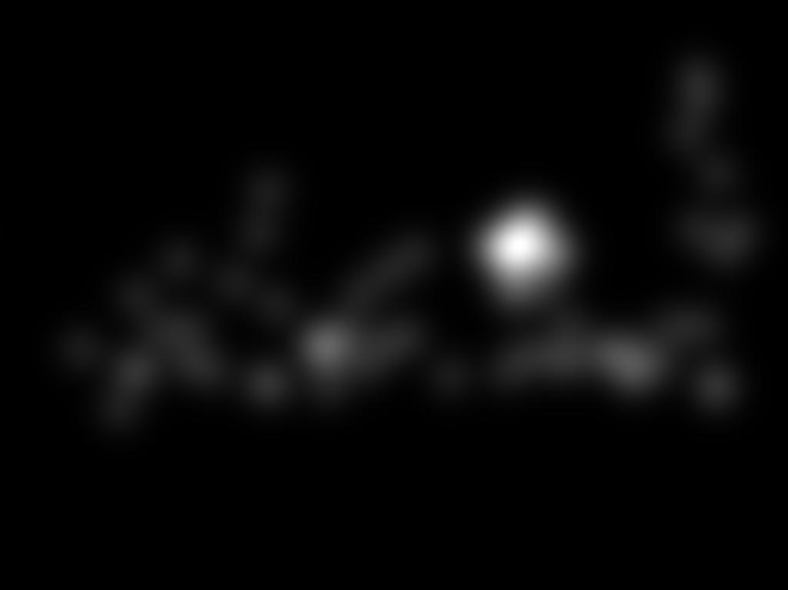
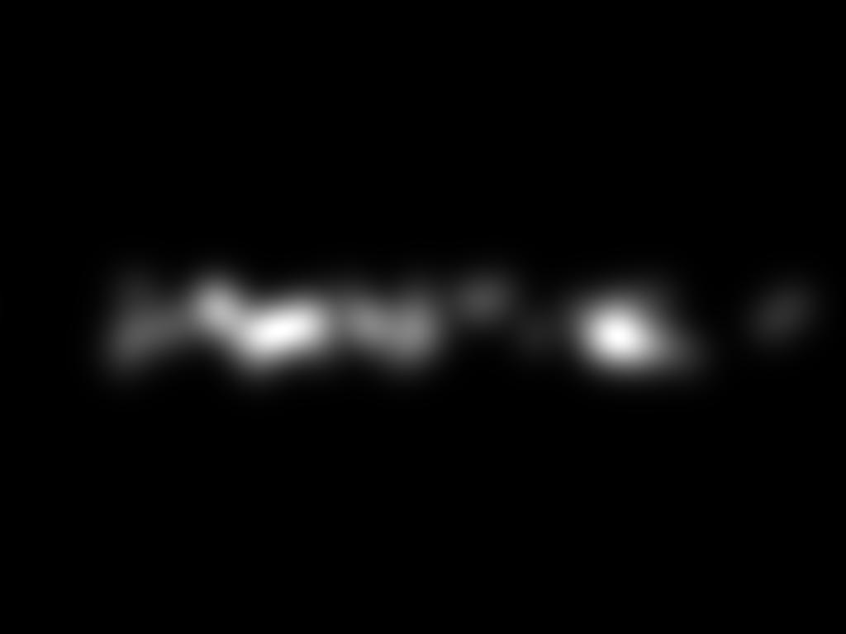
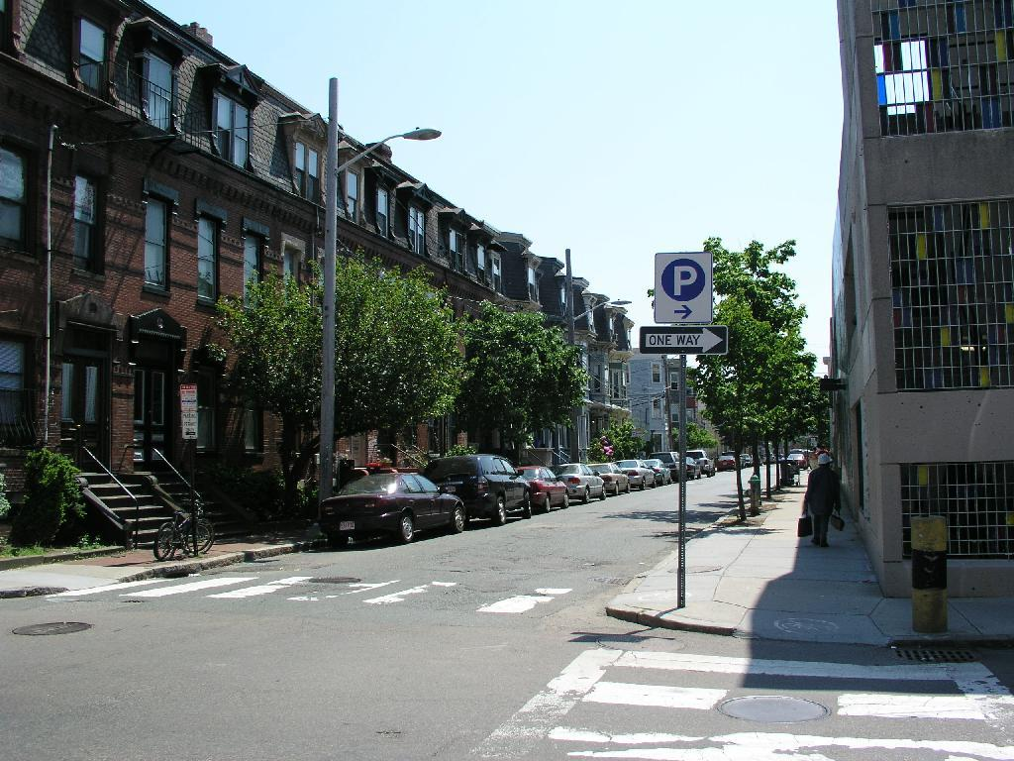
Experiments – Visual Saliency

Slide 44
Experiments – Visual Saliency
V2-V4-V5 excels at detecting intricate features, texture, contrast, and fine details
Dorsal-Ventral captures general spatial regions and motion patterns effectively
Vision Model | F1 Score
Dorsal-Ventral System | 0.41
V2-V4-V5 System | 0.59
F1 Scores of the 2 systems

Slide 45
Conclusion
Topology Manager is capable of orchestrating reasoning agents and achieved similar accuracy to CrewAI (~5% difference)
Phi-3.5-mini-instruct, after finetuning, achieved 89% accuracy on ReClor and 72% on LogiQA reasoning tasks
Dorsal-Ventral dual-stream agent reached 0.67 accuracy on CLEVR spatial estimation, compared to 0.48 for a baseline model
V2-V4-V5 hierarchical agent detected camouflaged objects with 0.89 accuracy on COD10K, surpassing Dorsal-Ventral at 0.80
Visual saliency prediction yielded an F1 score of 0.59 for V2-V4-V5 and 0.41 for Dorsal-Ventral streams

Slide 46
References
[Dennett1994] The Multiple Drafts Model of Consciousness. Daniel C. Dennett. In: Current Issues in the Philosophy of Mind. Oxford University Press. 1994.
[Sattin2021] Sattin, D.; Theoretical Models of Consciousness: A Scoping Review. Magnani, F.G.; Bartesaghi, L.; Caputo, M.; Fittipaldo, A.V.; Cacciatore, M.; Picozzi, M.; Leonardi, M. Brain Sci. 2021, 11, 535. https://doi.org/10.3390/brainsci11050535
[Jeong2024] Domain-specialized LLM: Financial fine-tuning and utilization method using Mistral 7B. Journal of Intelligence and Information Systems, Jeong, C. (2024). Korea Intelligent Information System Society. 2024
[Ravuru2024] Agentic Retrieval-Augmented Generation for Time Series Analysis. Chidaksh Ravuru, Sagar Srinivas Sakhinana, and Venkataramana Runkana. arXiv. 2024.
Guozhang Chen et al., A data-based large-scale model for primary visual cortex enables brain-like robust and versatile visual processing. Sci. Adv.8, eabq7592(2022). DOI: 10.1126/sciadv.abq 7592
Wang, AY, Kay, K, Naselaris, T, Tarr, MJ & Wehbe, L 2023, 'Better models of human high-level visual cortex emerge from natural language supervision with a large and diverse dataset', Nature Machine Intelligence, vol. 5, no. 12, pp. 1415-1426. https://doi.org/10.1038/s42256-023-00753-y
Krassanakis V, Perreira Da Silva M, Ricordel V. Monitoring Human Visual Behavior during the Observation of Unmanned Aerial Vehicles (UAVs) Videos. Drones. 2018; 2(4):36. https://doi.org/10.3390/drones2040036
Wenguan Wang, Jianbing Shen, Jianwen Xie, Ming-Ming Cheng, Haibing Ling, & Ali Borji (2019). Revisiting Video Saliency Prediction in the Deep Learning Era. IEEE Transactions on Pattern Analysis and Machine Intelligence, 1-1.
[Hulse2021] A connectome of the Drosophila central complex reveals network motifs suitable for flexible navigation and context-dependent action selection. Brad K. Hulse; Hannah Haberkern; Romain Franconville;
J. Ruan, W. Yuan, Z. Lin, N. Liao, Z. Li, F. Xiong, T. Liu, and Y. Fu, “MM-CamObj: A Comprehensive Multimodal Dataset for Camouflaged Object Scenarios,” arXiv preprint arXiv:2409.16084, 2024, doi: 10.48550/arXiv.2409.16084.

